Slide 2
TEAM PRESENTATION
Tapan Desai
(CSU ID: 2777437)
Shaishav Shah (CSUID:2835285)
Kinjal Patel
(CSUID:2794458)
Mitee Patel
(CSU ID: 2817313)

Slide 3
Power Management System
Scope
It is a web application project which will provide administration functionalities for admins to handle the management of bills, and provide payment gateway for final payment for the bills to the customers
This Project helps User and Admin
to securely log-in into the system and manage different activity such as; edit, view, look up details and pay bills.
Constraints
we don’t have access to get the actual bill data and no actual payment would be processed

Slide 4
Tools Used
Eclipse or IntelliJ (Java)
Visual studio code (React )
MySQL (Database + Server)
Xampp Server (Apache and MySQL)
Github
https://github.com/mitee163/CIS634_FinalProject_TSM

Slide 5
Pages
Registration page
Login page
Generate Bill page
Bill Status page
User Details page
Admin Details page

Slide 6
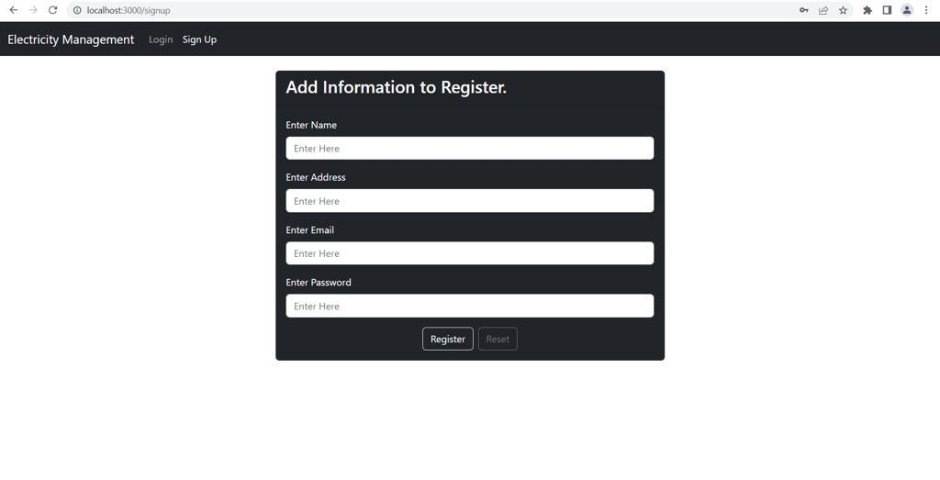
Registration Page
User enters the required details to register successfully.

Slide 7
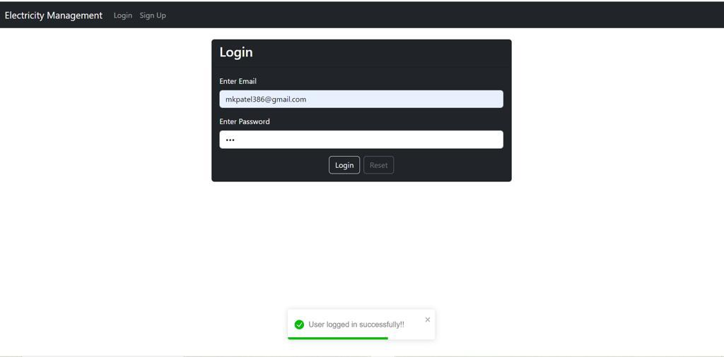
Login Page
If the email and the password entered by the user matches the database, then the message will appear “ User logged in successfully!!”

Slide 8
Bill pages
VIEW BILL PAGE
The bill details page will be opened.
BILL DETAILS PAGE
The edit bill details page will be opened.
EDIT BILL PAGE
BILL DUE WARNING
The edit bill details page should be saved, and a success message should be displayed to the admin opened
A warning should be sent to the user

Slide 9
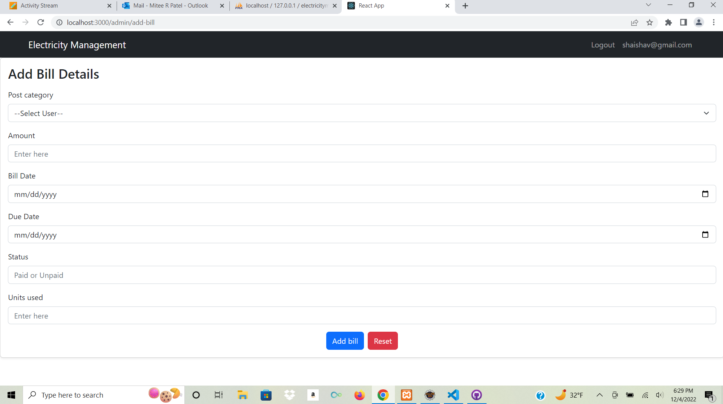
Generate Bill page
The edited bill details should be saved, and a success message should be displayed to the admin.

Slide 10
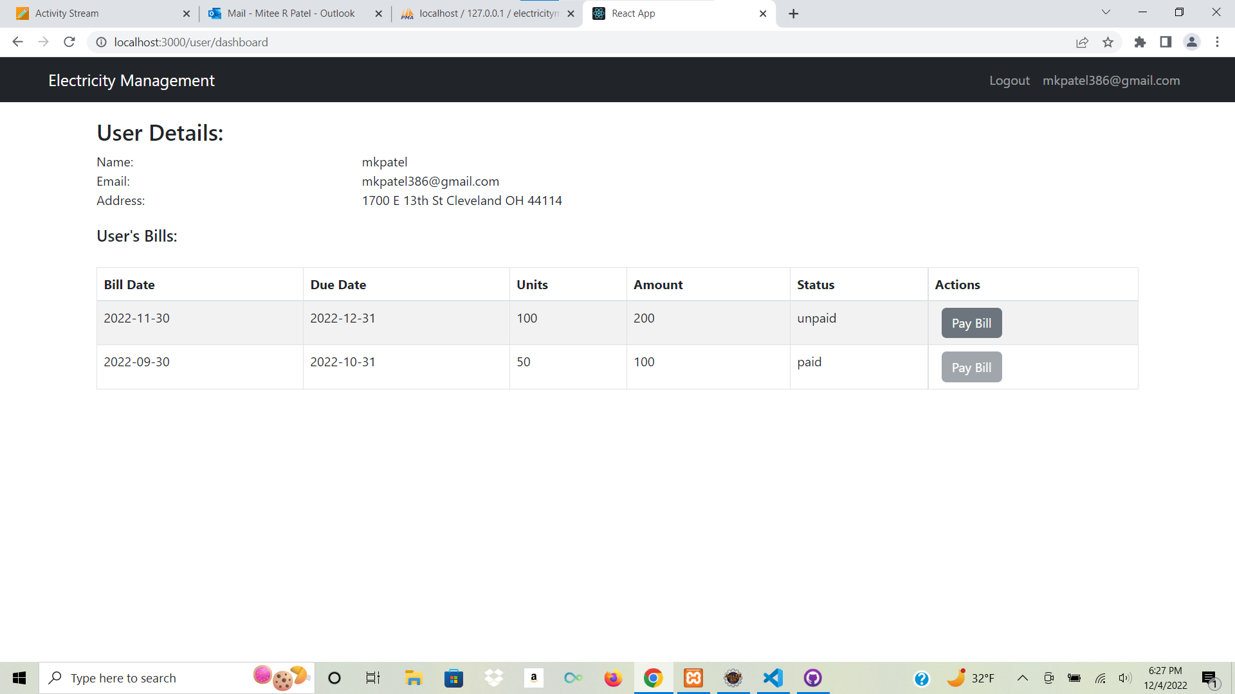
User Bill Details

Slide 11
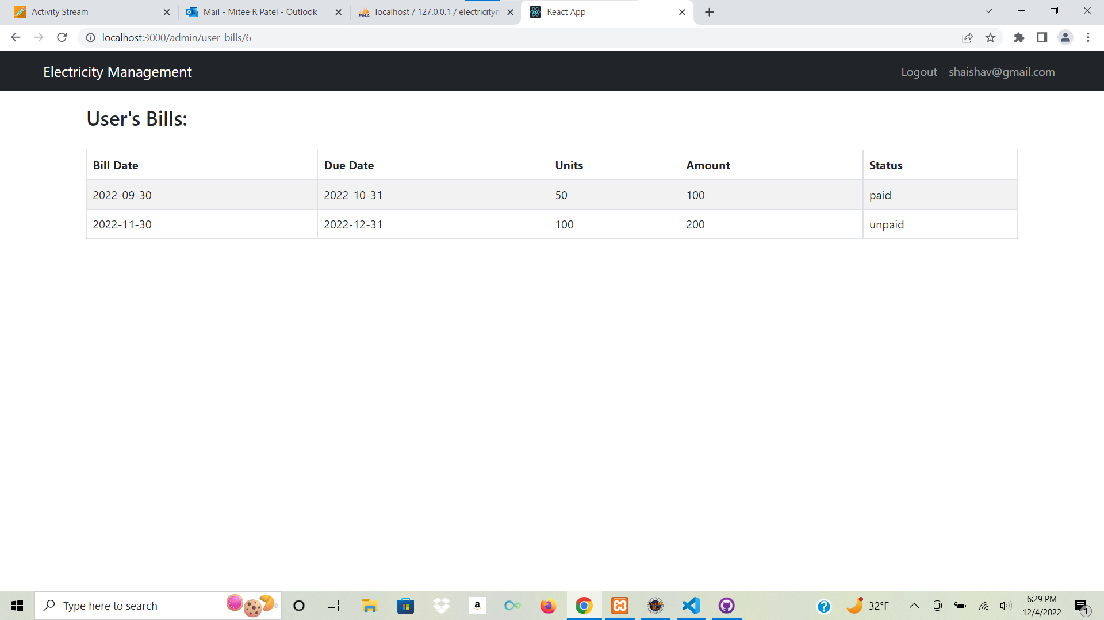
Bill Status Page

Slide 12
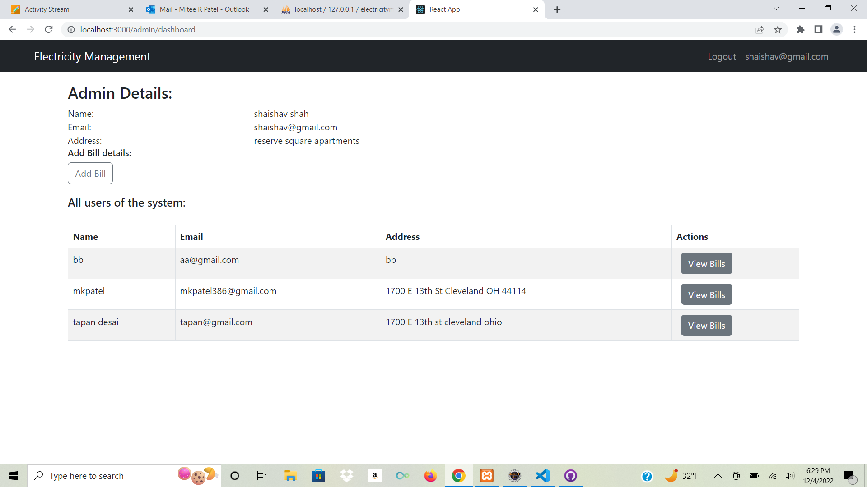
Admin Details
Page
If the admin clicks on the view bills button, then admin can view page containing all the bills of that user.

Slide 13
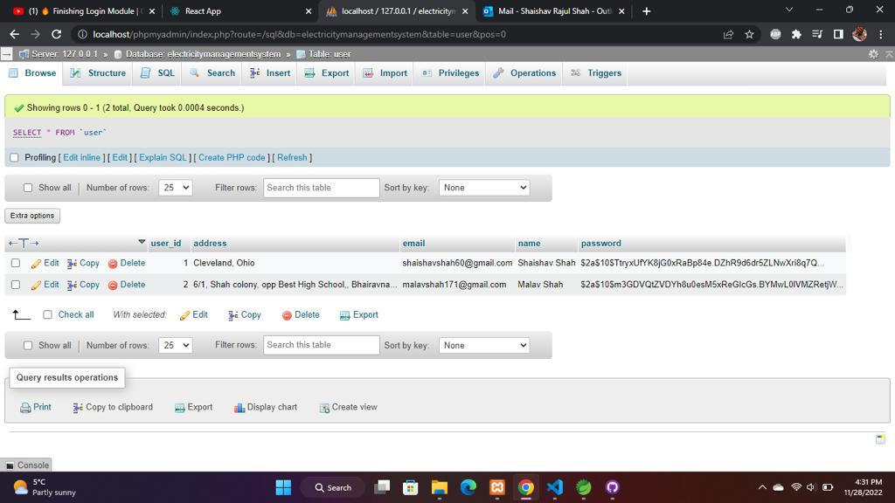
Database

Slide 14
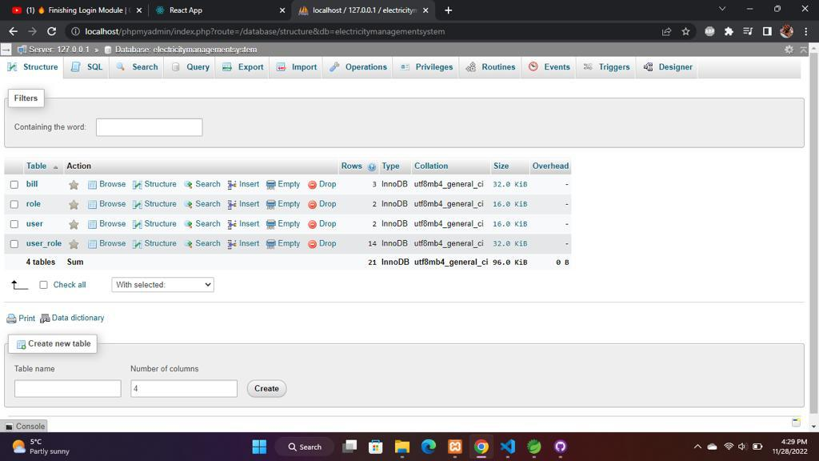
Main Table

